Slide 1

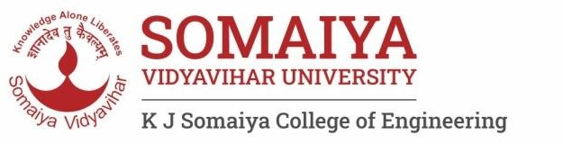

Computer Organization and Architecture
Div C SY COMP
Sem III
AY 2024-25

Slide 2



Computer Organization and Architecture
Course Outcomes
At the end of successful completion of the course the student will be able to
CO 1. Describe and deﬁne the structure of a computer with buses
structure and detail working of the arithmetic logic unit and its sub modules
CO 2. Understand the Central processing unit with addressing modes and working of control unit in depth
CO 3. Learn and evaluate memory organization and cache structure
CO 4. Summarize Input output techniques and multiprocessor conﬁgurations

Slide 3
Module 1
Structure of a Computer System 1.1
Introduction of computer system and its sub modules,
Basic organization of computer and block level description of the functional units. Von Neumann model 1.2
Introduction to buses, bus types, and connection I/O devices to CPU and memory, PCI and SCSI

Slide 4
Introduction to buses, and connection I/O devices to CPU and memory
What is a Bus?
A communication pathway connecting two or more devices
Data connection between 2 or more devices connected to the computer
Usually broadcast ,Often grouped
– For Ex: A bus enables a computer processor to communicate with the memory or video card to communicate with the memory – e.g. 32 bit data bus is 32 separate single bit channels
Power lines may not be shown

Slide 5
Introduction to buses, and connection I/O devices to CPU and memory
A computer is full of buses
Highways that take information and power from one place to another.
This pathway is used for communication purpose and it is established between two or more computer components.
Having a high-speed bus is as important as having a good transmission in a car.
Ex: - If you have a 700-horsepower engine combined with a cheap transmission, you can't get all that power to the road.

Slide 6
Computer Busses
There are a number of possible interconnection systems
Single and multiple BUS structures are most common
e.g. Control/Address/Data bus (PC)
e.g. Unibus (DEC-PDP) (Digital Equipment Corporation-Programmed Data Processor)
Functions :
Data sharing - Serial/Parallel, 8-bit, 16-bit, 32-bit or even 64-bit buses.
Addressing - A bus has address lines which allows data to be sent to or from speciﬁc memory locations.
Power - A bus supplies power to various peripherals connected to.
Timing - System clock-synchronize the peripherals attached to it with the rest of the system.

Slide 7
Types of Buses
Address Bus : Memory Addressing Capability
Address bits n : memory capacity 2^n
Concept of memory size
1 K = 1024 = 2^10
1 M = 1 K x 1 K = 2 ^ 20
1 G = 2 ^ 30
1 T = 2 ^ 40

Slide 8
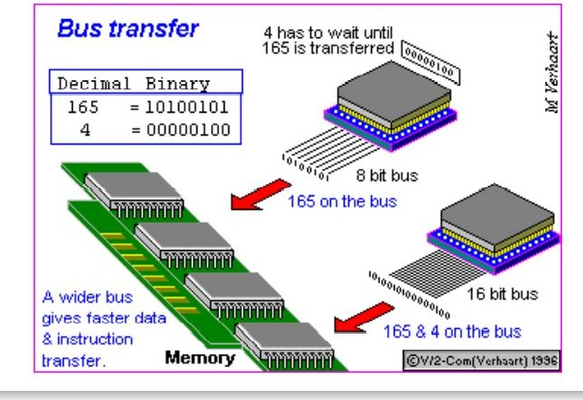
Types of Buses
Data Bus : Width of Data Operations
Carries data
Remember that there is no difference between “data” and “instruction” at this level
Width is a key determinant of performance – 8, 16, 32, 64 bit

Slide 9
Types of Buses
Data Bus : Width of Data Operations
Address Bus : Memory Addressing Capability
Control Bus : Controls activities of all units of a computer
Main Function is to carry control signals generated by control unit –
Ex: One line of control bus is used to indicate whether the CPU is reading/writing to the main memory
Control and timing information
Memory read/write signal
Interrupt request
Clock signals

Slide 10
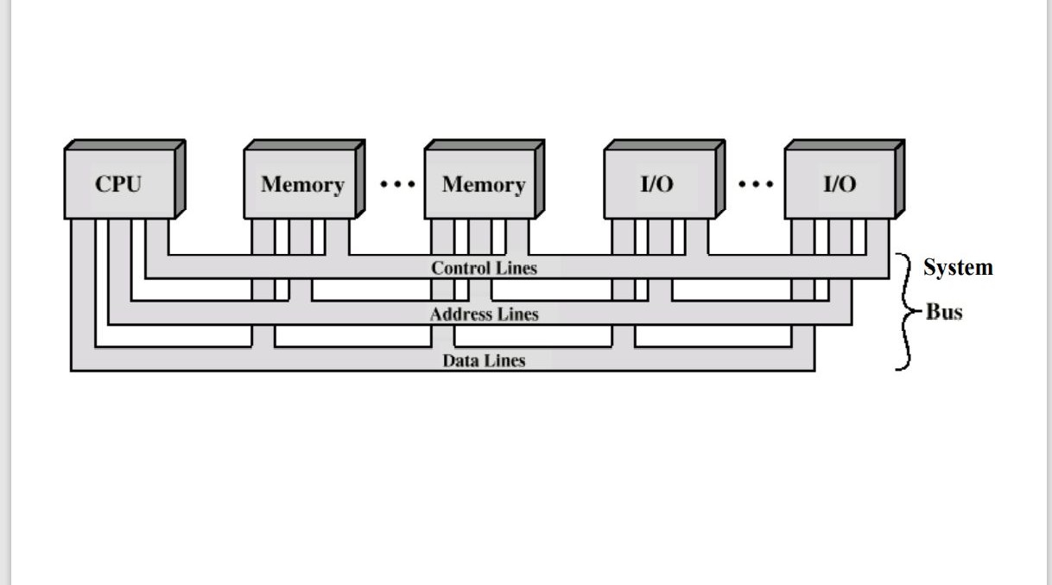
Bus Interconnection Scheme

Slide 11
Types of Buses
Single Bus :
Lots of devices on one bus leads to:
Propagation delays
Long data paths mean that co-ordination of bus use can adversely affect performance
If aggregate data transfer approaches bus capacity
Most systems use multiple buses to overcome these problems
Dedicated – Separate data & address lines
Multiplexed – Shared lines
Address valid or data valid control line
Advantage - fewer lines
Disadvantages : More complex control

Slide 12
Types of Buses
Multiple Masters / Controllers on the Bus
Bus Arbitration
Only one module may control bus at one time
Centralized Arbitration
Single hardware device controlling bus access
Bus Controller
Arbiter
May be part of CPU or separate
Distributed Arbitration
Each module may claim the bus
Control logic on all modules

Slide 13
Types of Buses
PCI Bus
SCSI Bus
Busses Before that
ISA Bus 8 bit , 16 bit
Characteristics : parallel/ serial, synchronous / asynchronous
Meaning of Standards and Protocols

